Slide 1







PROJECT TITLE:
QETC DASHBOARD
(Empowering Data-Driven Decision Making in Education)

Slide 2



Overview
1.Introduction
2.Problem statement
3.Objectives
4.Project scope

Slide 3
Overview
4.Solution
5.Demonstration
6. conclusion

Slide 4

Presenter: Ahmed Abdi Mohamed
Matrix Number: B032020059
Course: BITU3973 PROJECT I
(Final year project 1)
Group: BITI S1G1
Date: [04/7/2023]

Slide 5




Introduction
Good afternoon, everyone. Today, I'm excited to present to you the final year project, the QETC Dashboard. This project aims to address the challenges faced by the QETC program in managing student exchanges and provide a solution that streamlines the process and enhances decision-making.

Slide 6

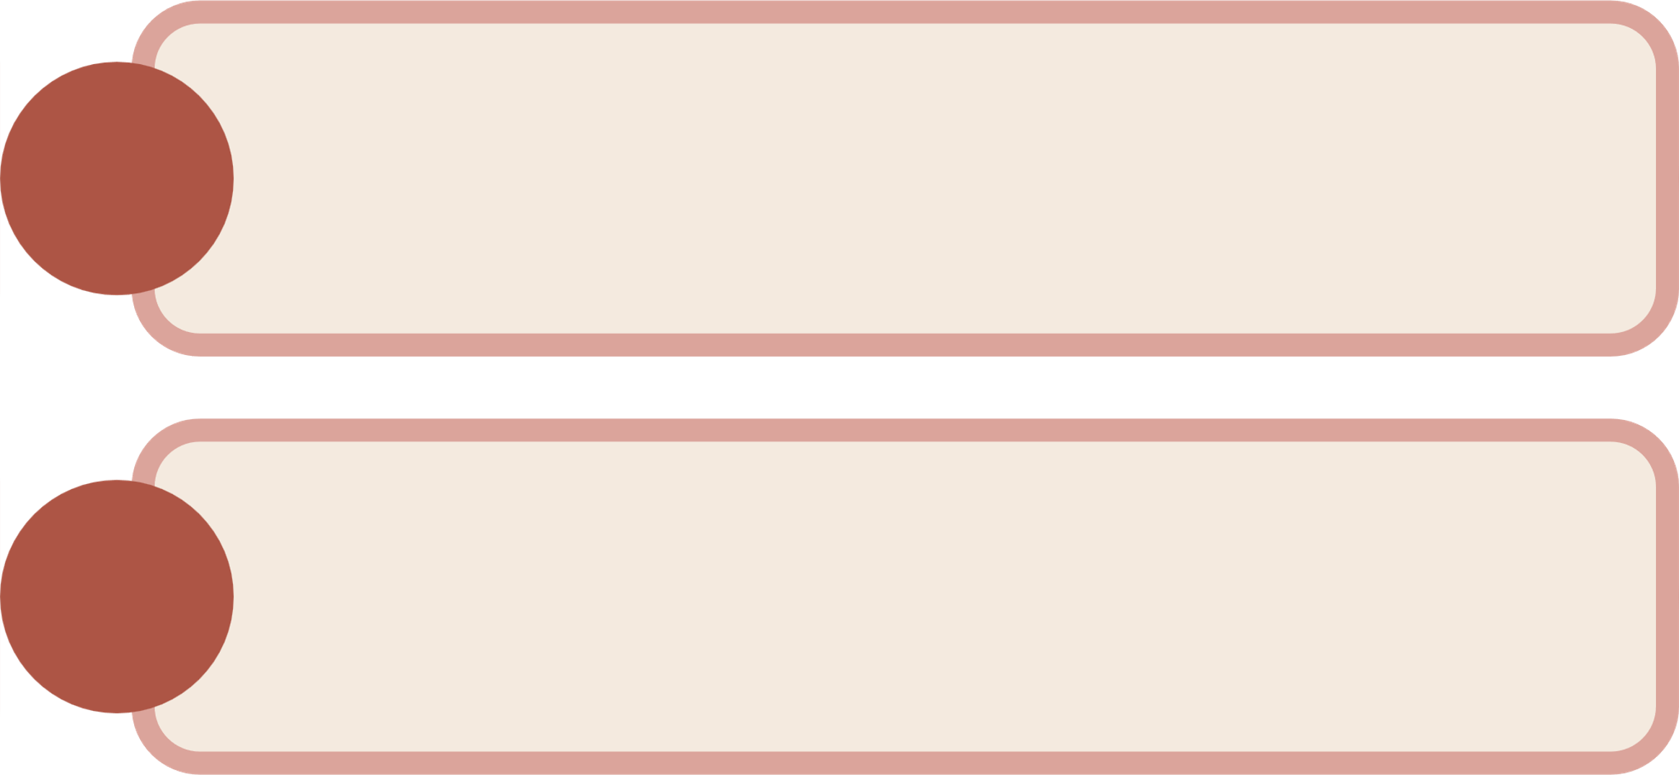
Problem Statement
1.
The QETC program lacked an efficient and user-friendly system for analyzing student enrollment data.
2.
Administrators and stakeholders faced challenges in understanding enrollment trends, commission distributions, and other key metrics necessary for effective planning and decision making.

Slide 7
3.
Lack of centralized data, limited insights, and manual data handling hinder efficient decision-making and growth opportunities.
4.
Purpose of the QETC Dashboard: To address these challenges and transform educational institutions' operations through data-driven solutions.

Slide 8
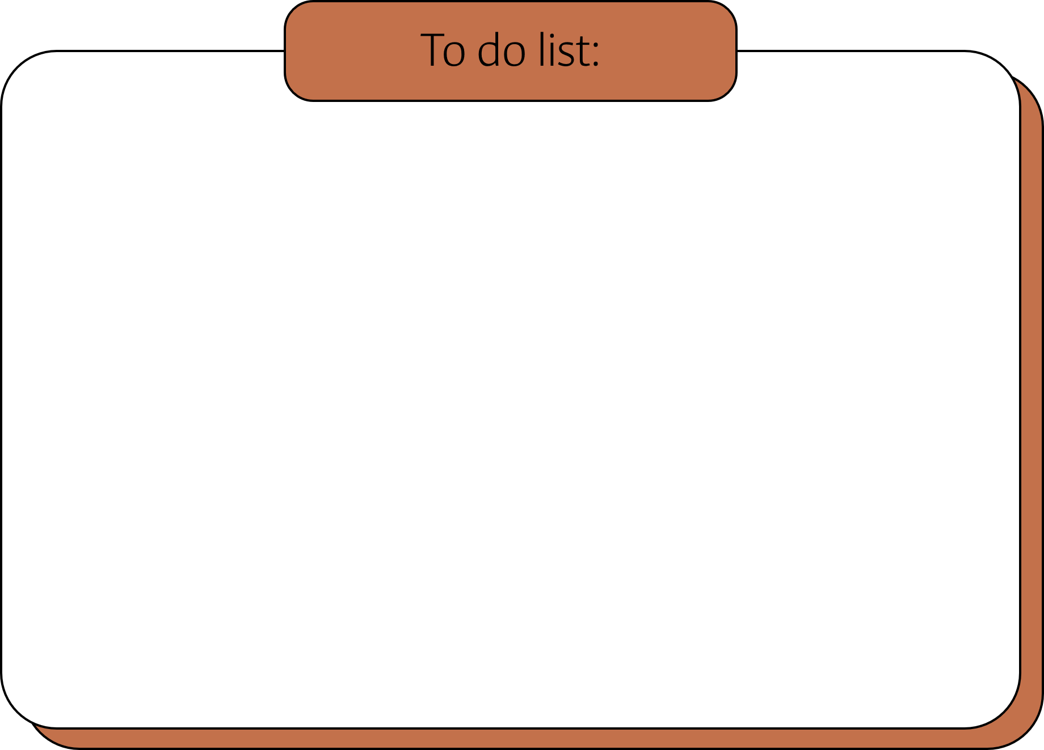
OBJECTIVES
OBECTIVE 1
To propose and analyze the number of students enrolled in the QETC program over a specific period, leveraging historical data. By analyzing enrollment trends, we can identify patterns and factors that influence student participation. This analysis will provide valuable insights for program development, marketing strategies, and resource allocation.

Slide 9
OBECTIVE 2
To develop a predictive model that forecasts the number of students for future enrollment periods. By incorporating machine learning algorithms and data analytics techniques, we can generate accurate predictions, enabling QETC administrators to plan ahead and make informed decisions. This predictive capability will greatly enhance the program's efficiency and effectiveness.

Slide 10
OBECTIVE 3
To visualize the dashboard, We have have designed a user-friendly interface that presents the data in an intuitive and interactive manner. Through visualizations such as charts, graphs, and maps, stakeholders can easily explore and understand key metrics, including student demographics, program popularity, university distribution, and commission trends. The dashboard provides a holistic view of the program, allowing administrators to identify strengths, weaknesses, and opportunities for improvement.

Slide 11


project scope
2. Identify enrollment trends, program popularity, peak seasons, and student preferences
1.Analyze data from 2018 to present, including student demographics, program specifics, marketing initiatives, and financial records.

Slide 12
project scope
4.Develop predictive analytics capabilities for student enrollment, resource needs, and financial predictions for 2023
3.Design a user-friendly and visually appealing data analytics dashboard for QETC stakeholders.

Slide 13
solutions
The solution we propose for the challenges faced by the QETC program is the development of a comprehensive and intelligent dashboard that incorporates advanced data analytics and predictive modeling techniques

Slide 14
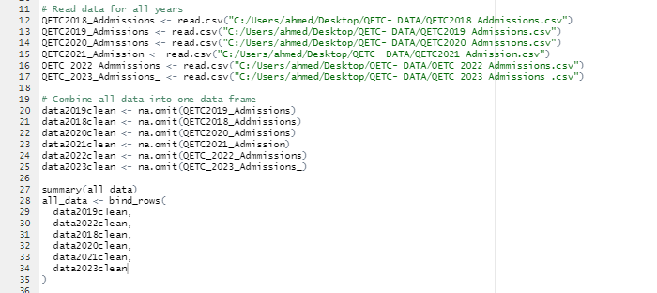
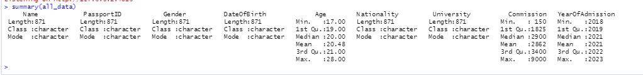
Solution 1:Data Integration and Preprocessing:
To ensure accurate and reliable data, we have implemented a data integration and preprocessing module. This module collects data from various sources, such as student records, program databases, and marketing campaigns. The collected data is then standardized, cleansed, and transformed into a consistent format suitable for analysis.

Slide 15
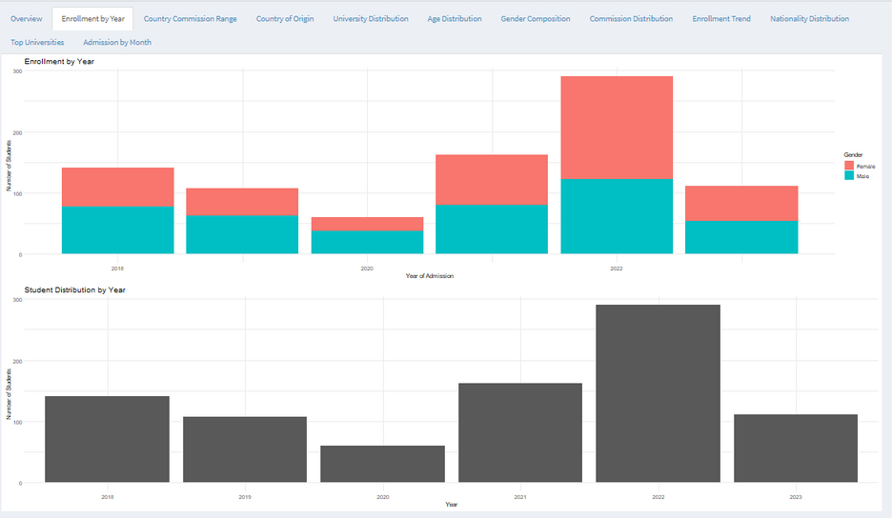
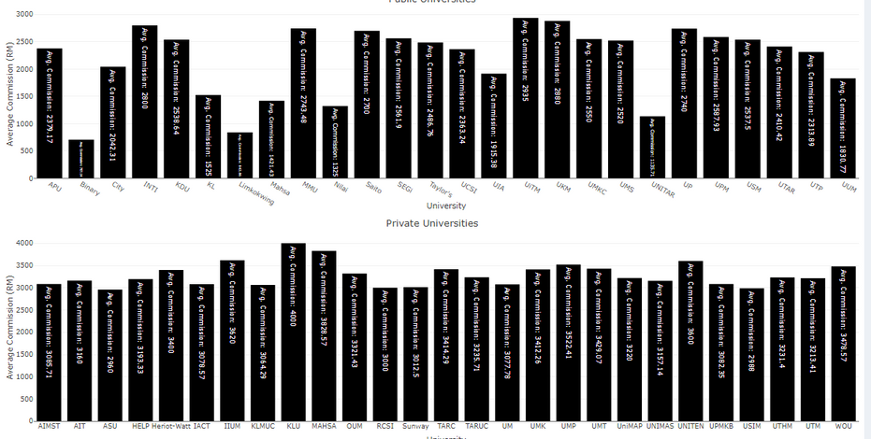
solution 2: Data Analysis and Visualization:
The dashboard offers a wide range of data analysis and visualization capabilities. Administrators can explore student demographics, including age, gender, and nationality, through interactive charts and graphs. They can also analyze program-specific metrics such as university distribution, enrollment trends, and commission patterns. These visualizations provide a clear and intuitive representation of the data, enabling administrators to identify trends, patterns, and areas of improvement.

Slide 16
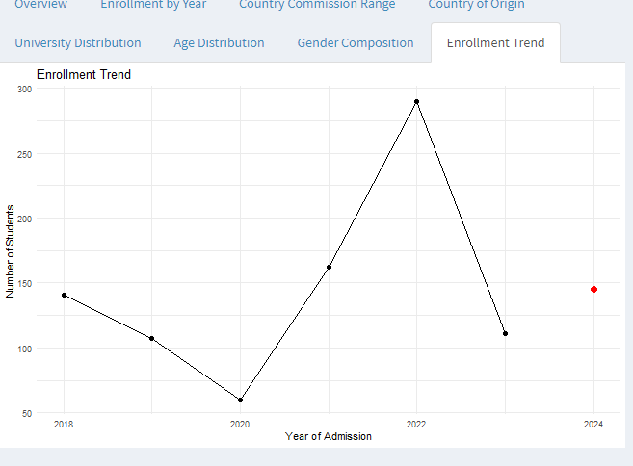
solution 3: Predictive Modeling:
One of the key features of the QETC Dashboard is its predictive modeling capability. By leveraging historical data and employing advanced machine learning algorithms, the dashboard can forecast future enrollment numbers. Administrators can access these predictions for different time periods, allowing them to proactively plan resources, allocate budgets, and optimize program offerings. The predictive models take into account various factors, such as past enrollment trends, marketing campaigns, and external influences, to provide accurate and reliable forecasts.

Slide 17

Demonstration

Slide 18


Conclusion
In conclusion, the QETC Dashboard offers a comprehensive solution to the challenges faced by the QETC program in managing student exchanges. Through data analysis, predictive modeling, and intuitive visualization, the dashboard empowers administrators to make informed decisions, allocate resources effectively, and enhance the overall student exchange experience.

Slide 19






Slide 20







Question Time

